Slide 1

HEALTH INFORMATION SYSTEM
OMBATI EMMANUEL BOSIRE
26TH APRIL 2025
CEMA ASSIGNMENT TASK 1

Slide 2
INTRODUCTION
Problem: Health data management is often inefficient and prone to human error in traditional systems.
Solution: The Health Information System automates client registration, program enrollment, and data tracking.
Goal: To improve efficiency, accuracy, and accessibility of health program data for administrators.

Slide 3
SYSTEM APROACH
Backend: Flask framework for web development.
Database: SQLite for local, lightweight storage.
Frontend: HTML and CSS for user interface design.
Key Features:
Client registration
Program enrollment
Searchable client database
View client profiles

Slide 4
SYSTEM ARCHITECTURE
Visual: Add a high-level architecture diagram here (e.g., flow from frontend to backend,
and database interactions).
Description:
Frontend: User interacts with HTML pages (forms, tables).
Backend: Flask application handles requests and connects to the SQLite database.
Database: Stores data for clients, programs, and enrollments.
.

Slide 5
DATABASE DESIGN
Tables:
Clients: Stores client information (name, contact details, etc.).
Programs: Lists available health programs.
Enrollments: Links clients to programs they are enrolled in.

Slide 6
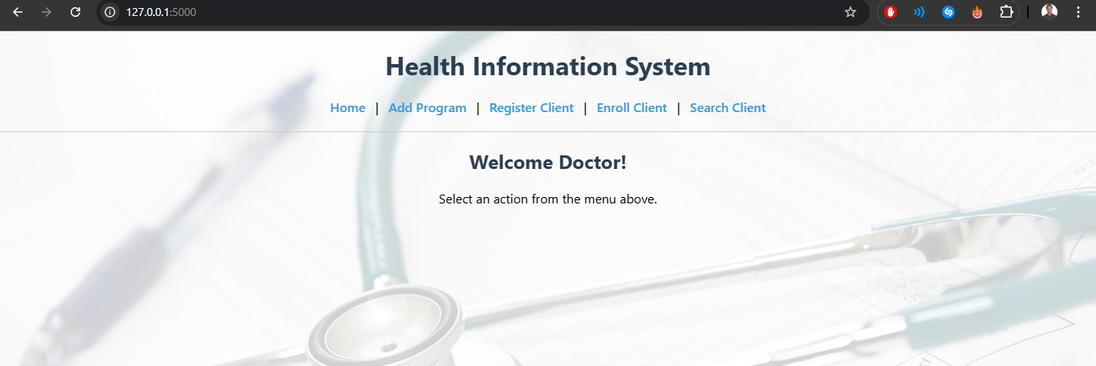
USER INTERFACE
UI Design: Simple, clean, hospital-friendly design with blue and green colors.

Slide 7
SOLUTION
Solution: The system automates and organizes the process of registering clients, enrolling them in health
programs, and tracking their data.
Benefits:
Increased efficiency and reduced manual effort.
Real-time access to client and program data.
Improved accuracy and fewer errors in client data management.
Easy reporting and tracking of health programs.

Slide 8
CHALLENGES AND LIMITATIONS
Challenges:
Managing large data volumes while maintaining system performance.
Ensuring data security and user authentication.
Limitations:
The system currently does not support user roles or authentication.
Future work will focus on expanding reporting features and adding more user security.

Slide 9
CONCLUSION
Conclusion: The Health Information System successfully addresses the need for
efficient client management and program enrollment in health organizations.
Next Steps:
Add features like user authentication and role management.
Improve system scalability for larger datasets.
Expand the system to include advanced reporting and analytics.

